Slide 1
CareerBridge Pro
Smart Career Learning & Placement System
User Feedback, SWOT &
Final Features List,STRATEGY
Group No : 5
Team Name: Bridgify

Slide 2
IDEA
Understand user needs, problems, and expectations in career planning, learning, and job searching.
S0LUTION
CareerBridge Pro integrates learning, skill analysis, and job matching into one platform.

Slide 3
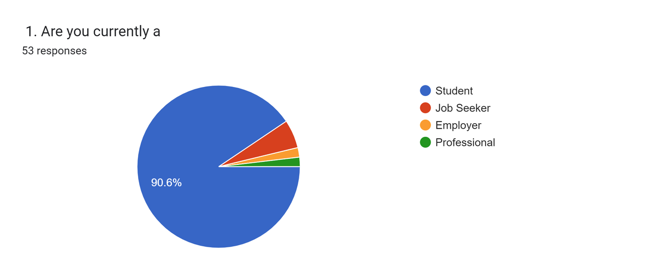
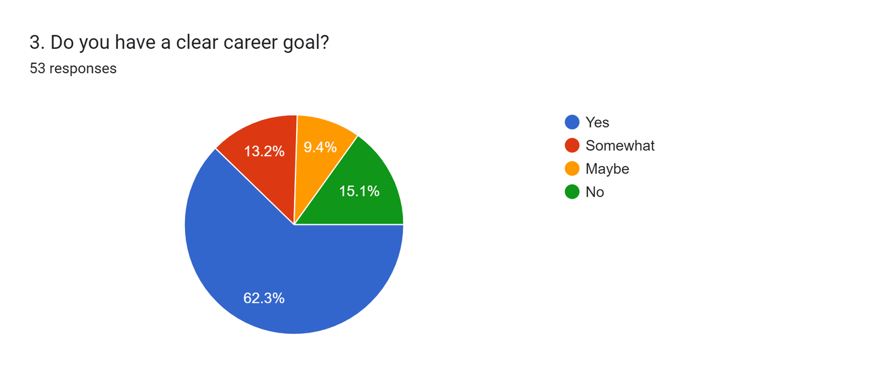
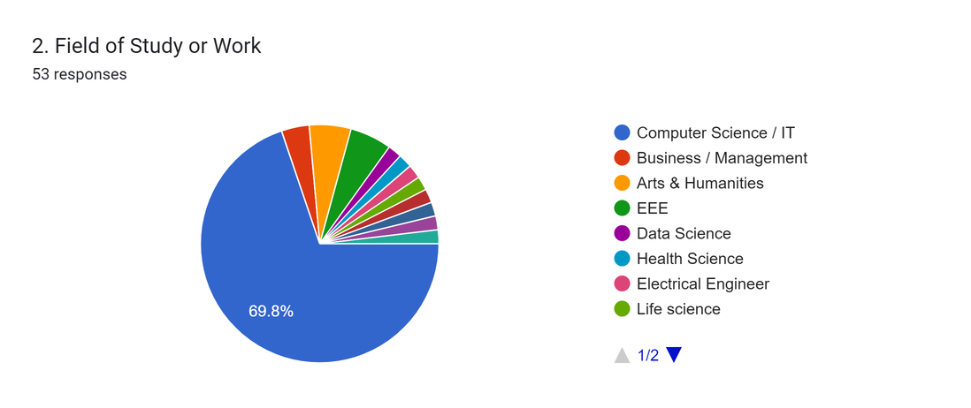
User FeedBack
Most respondents are students, with a smaller portion being job seekers and employed individuals.
Users come from diverse academic backgrounds, with a majority from technical and business-related fields.
Many users are not fully satisfied with their current career direction and feel uncertain about their future path.

Slide 4
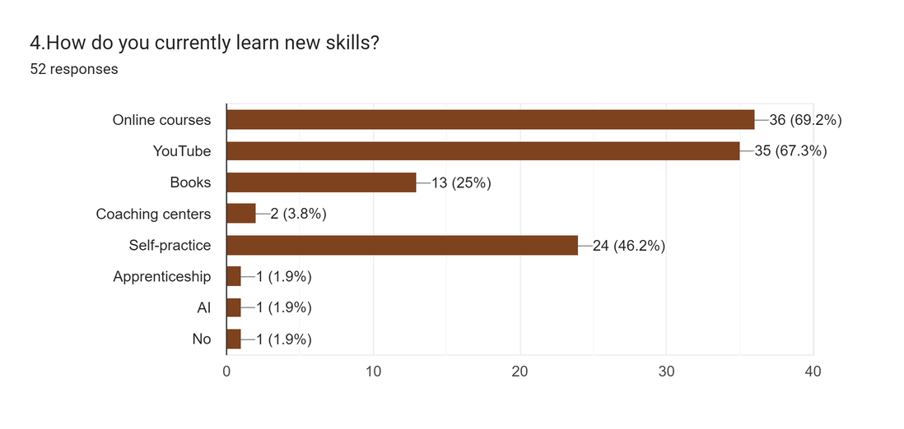
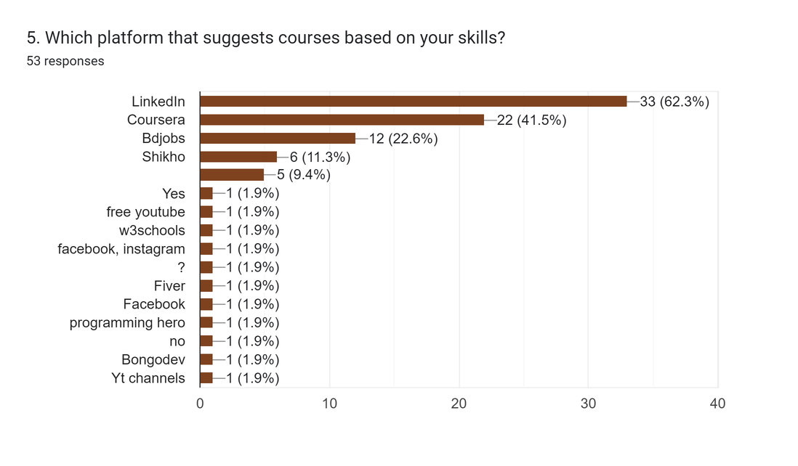
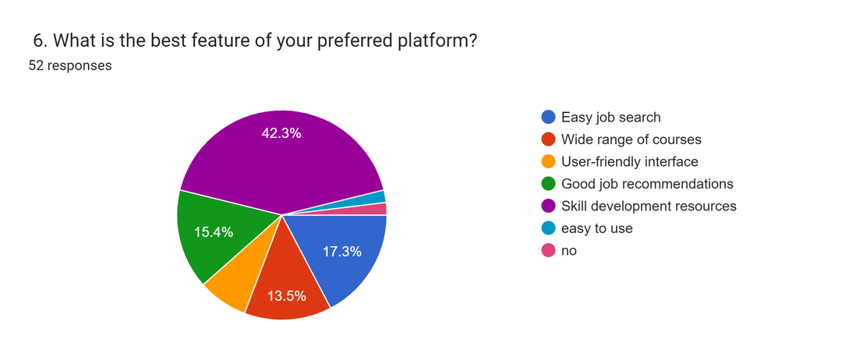
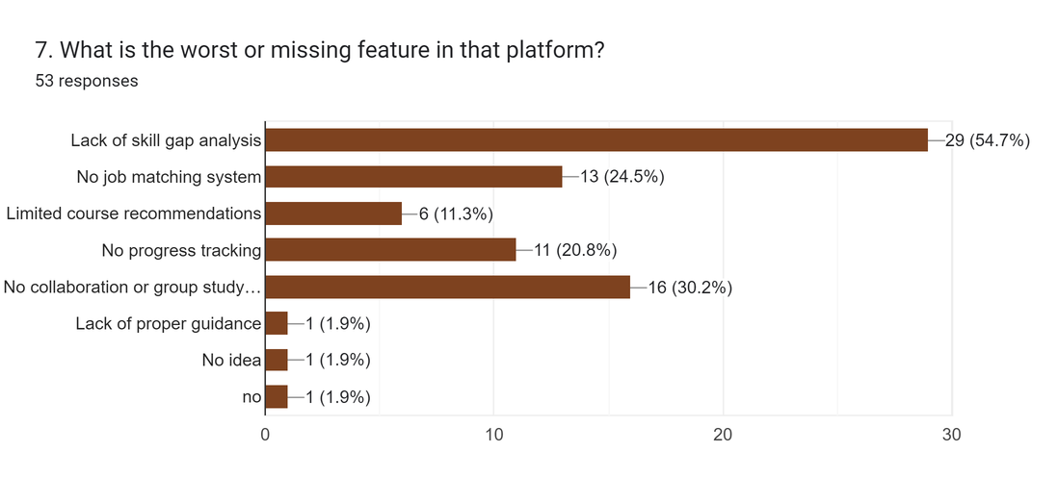
User FeedBack
Many users face difficulties in career planning due to lack of clear direction.
Common challenges include lack of guidance, skill gaps, and limited opportunities.
Most users prefer flexible learning methods such as online courses and video-based learning.
A significant number of users have experience using existing career or learning platforms.

Slide 5
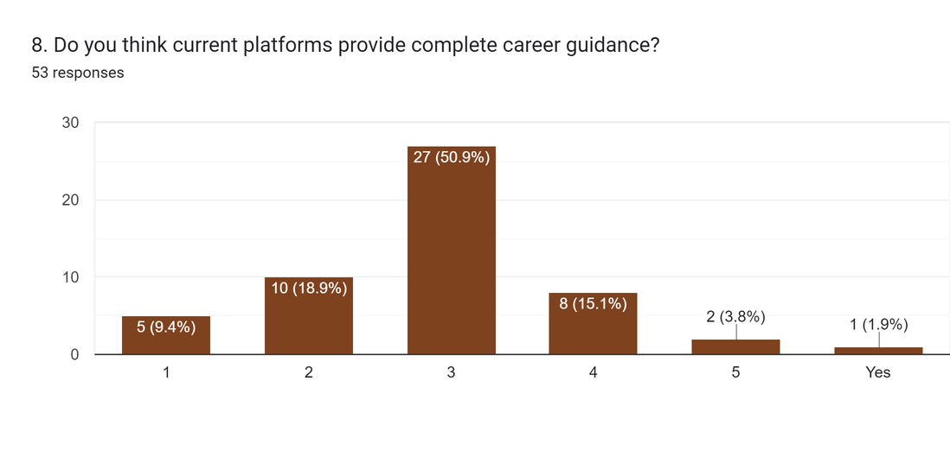
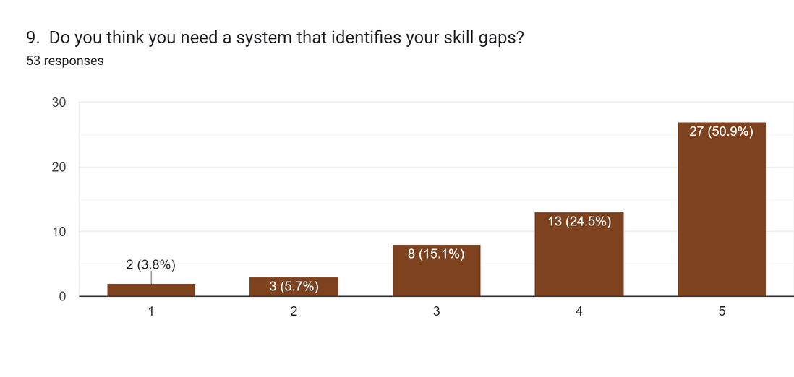
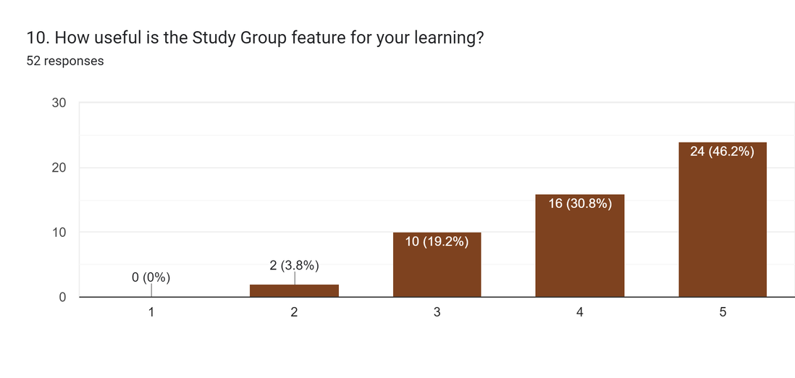
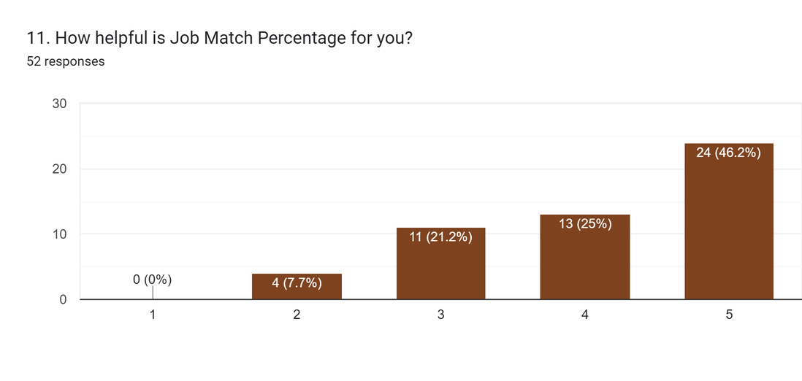
User FeedBack
A significant number of users have experience using existing career or learning platforms.
Most users express a strong need for mentorship and expert guidance.
Users are highly interested in practicing through mock interview features.
Many users prefer group study systems for collaborative learning.

Slide 6
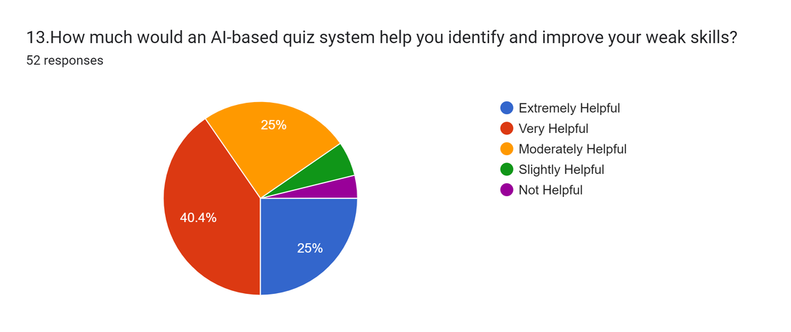
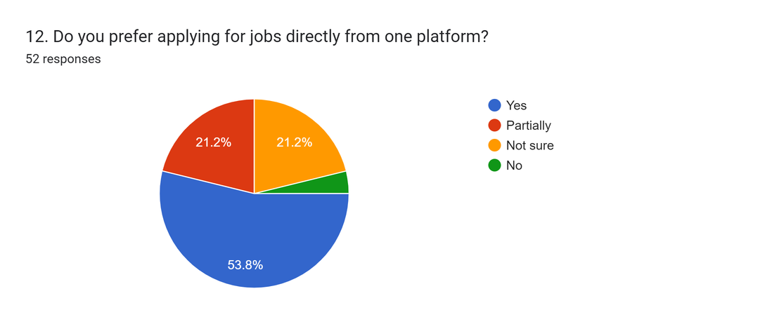
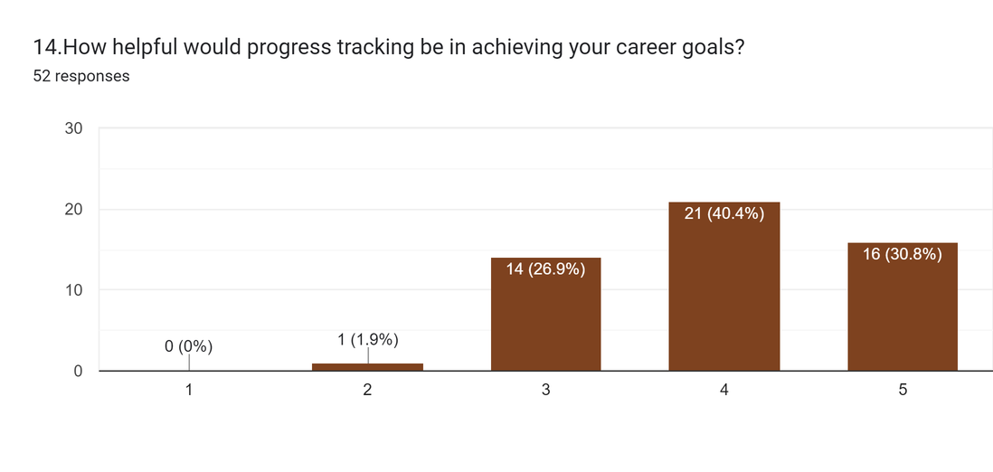
User FeedBack
Personalized course recommendations are considered very useful by most users.
Notifications and reward systems are seen as motivating factors by users.
Users need proper support and resources for effective job preparation.

Slide 7
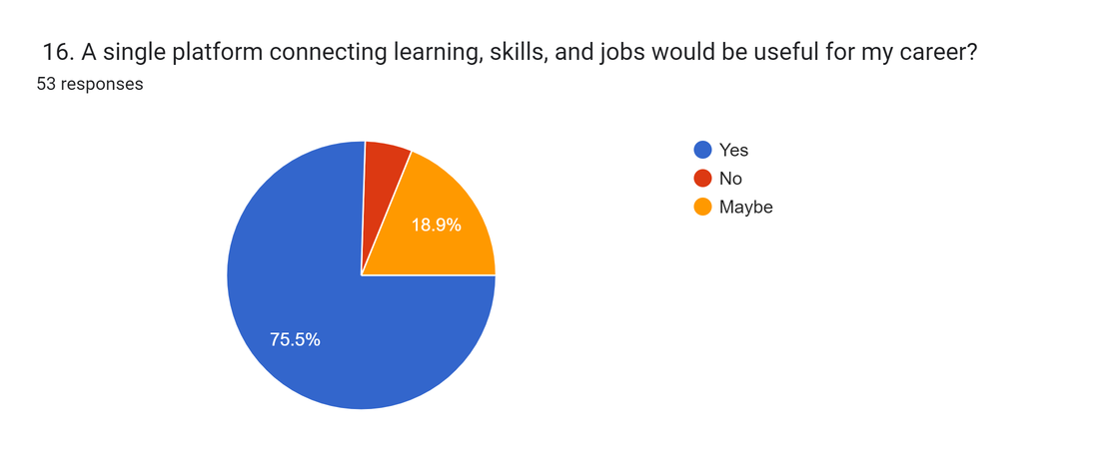
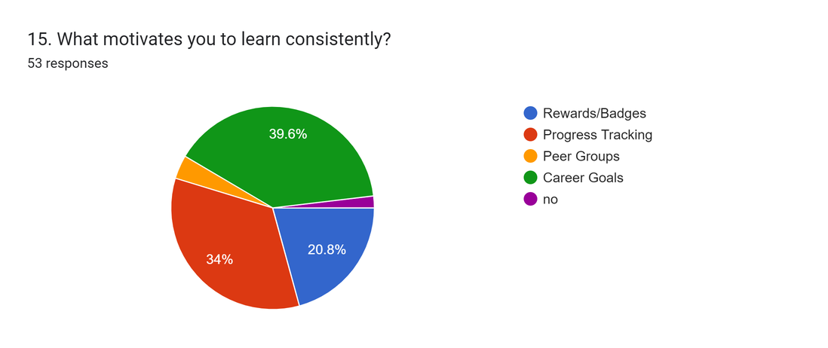
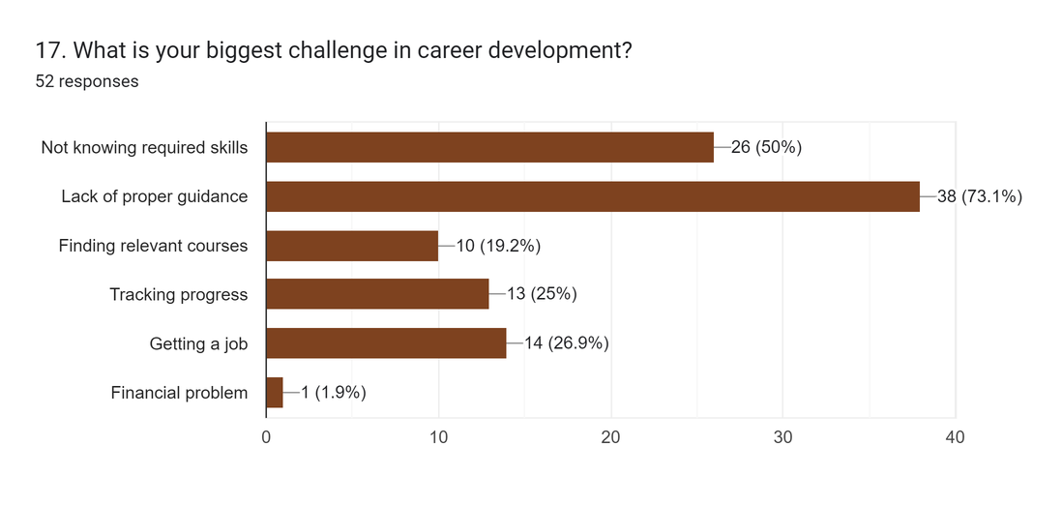
User FeedBack
Users expect a simple, clean, and user-friendly platform interface.
Most users are willing to use this system in the future.
Users provide valuable feedback and suggestions for improving the system.

Slide 8
Features
Smart Profile System
Job Matching System
Study Group System
AI Skill Gap Analyzer
Application System
Course Recommendation
Career Path Planner
Employer Panel
Notifications & Rewards
Online Quiz System
Performance Tracking
Mock Interview

Slide 9
SWOT
Strengths
Weaknesses
  All-in-one system (Learning + Skill + Job)
  Skill gap & job match feature (unique)
  Personalized career guidance
  Depends on accurate user data
  Initial development complexity
  Needs strong database & AI logic
Opportunities
Threats
  High demand among students & job seekers
  Growing EdTech + Job market in Bangladesh
  Can partner with companies & institutes
  Strong competitors (LinkedIn, Bdjobs, Coursera)
  User trust building is challenging
  Rapid technology changes
  Focus on unique features like Skill Gap Detection and Job Match % to stand out from competitors.
  Ensure simple interface and personalized recommendations for better user experience.
  Primarily target students and fresh graduates who need career guidance.
  Collaborate with universities, training institutes, and companies for growth.
  Update system regularly based on user feedback and improve accuracy.
  Expand features and services gradually to reach a larger audience.
Strategy

Slide 10
Source form (as provided): Open survey responses

